Slide 1

Tobacco Awareness
Presented by:
Mohammed Karimul Mowla
Md Ariful Islam

Slide 2

Introduction
Tobacco use is a major problem among young people. Many students want to quit but they do not get proper guidance or motivation.This mobile app will help users quit tobacco through daily plans, motivation, tracking, and support.

Slide 3

Problem Statement
Many users fail to quit tobacco because:
They do not know their addiction level
They do not follow a proper quit plan
They lack motivation and reminders
They do not have support during cravings
This project aims to solve these problems through a simple and structured mobile app.

Slide 4

The Solution:
This project aims to solve these problems through a simple and structured mobile app. The Solution: "Tobacco Awareness"
A mobile-based support system that divides the quitting process into manageable daily activities.
Provides immediate craving management tools (SOS, timers, breathing).
Encourages users through financial tracking and gamification

Slide 5
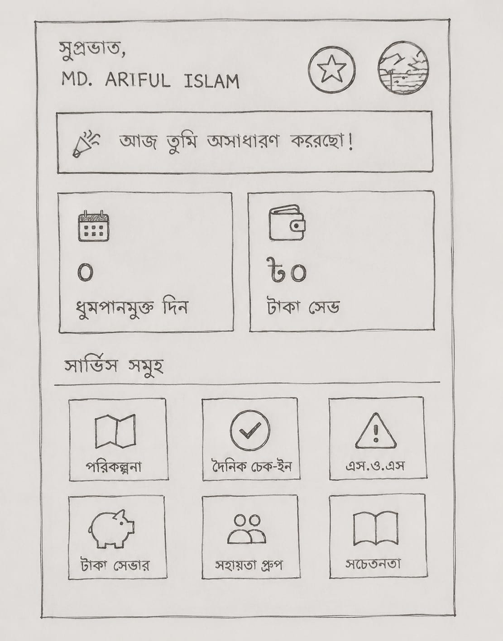
Key Features
Quit Plan
Daily Check-In
SOS Craving Support
Survival Timer
Money Saving Tracker
Peer Support & Counseling
Gamification (XP, Badges)
Awareness Content
Notifications

Slide 6
Stakeholders
Tobacco Quitter: Uses the system to quit tobacco and track progress.
Peer Counselor: Provides support and motivation to users.
Moderator: Ensures content quality and compliance.
Medical Advisor: Provides verified health guidance.
System Administrator: Manages system operations and security.
Project Owner: Provides oversight and approves major decisions.

Slide 7
Requirement Elicitation Techniques
Techniques | Tobacco Quitter | Peer Counselor | Moderator | Medical Advisor | Project Owner
Interview | ✓ | ✓ | ✓ | ✓ | ✓
Workshops | ✗ | ✗ | ✗ | ✗ | ✗
Focus Group | ✓ | ✗ | ✗ | ✗ | ✗
Observation | ✗ | ✗ | ✗ | ✗ | ✗
Questionnaires | ✓ | ✓ | ✓ | ✓ | ✓
User Interface Analysis | ✓ | ✓ | ✓ | ✗ | ✗

Slide 8
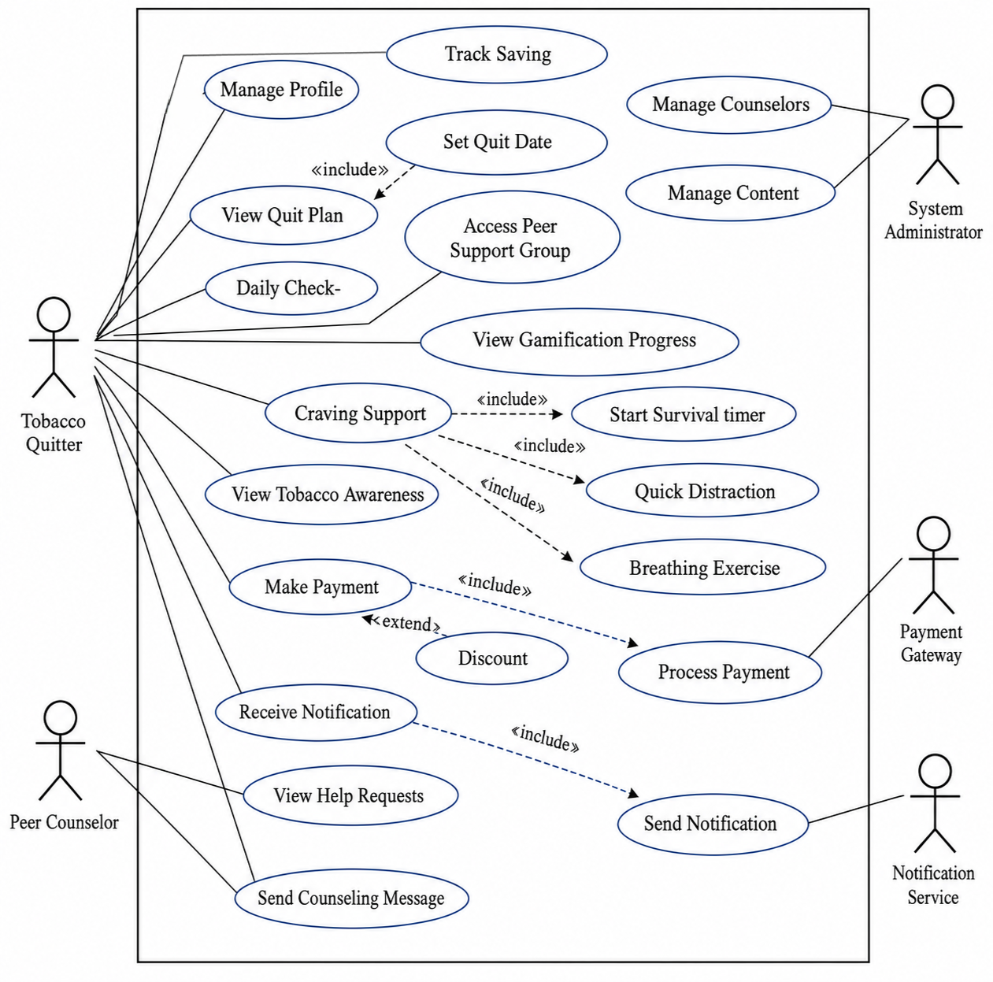
Use-Case Diagram

Slide 9
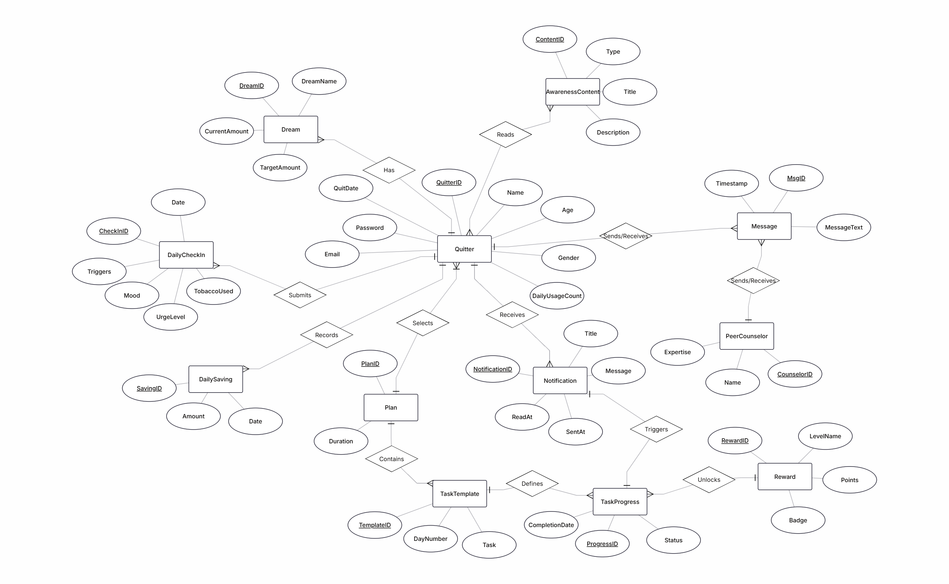
Entity Relationship Diagram

Slide 10
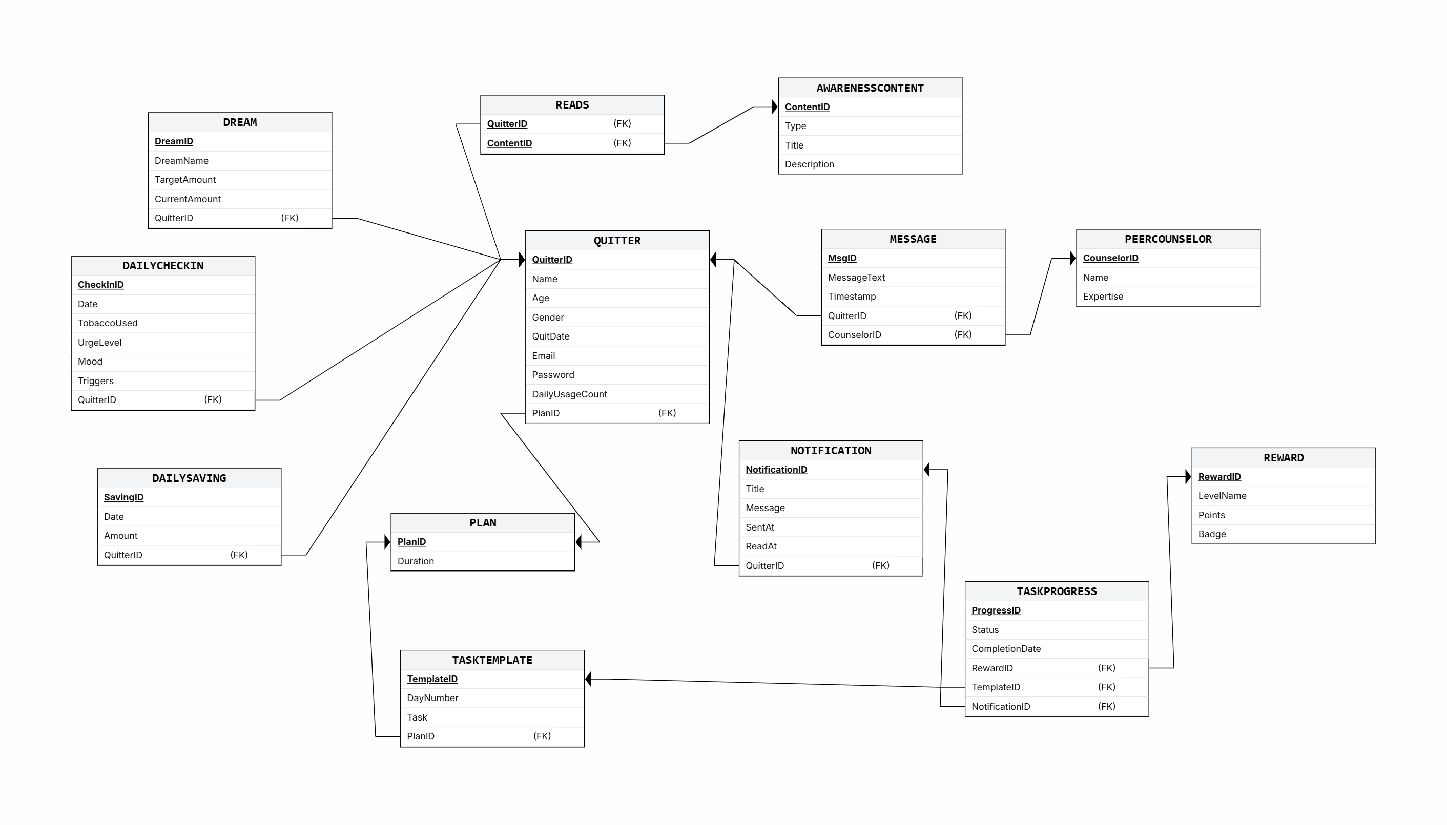
Relational Schema

Slide 11
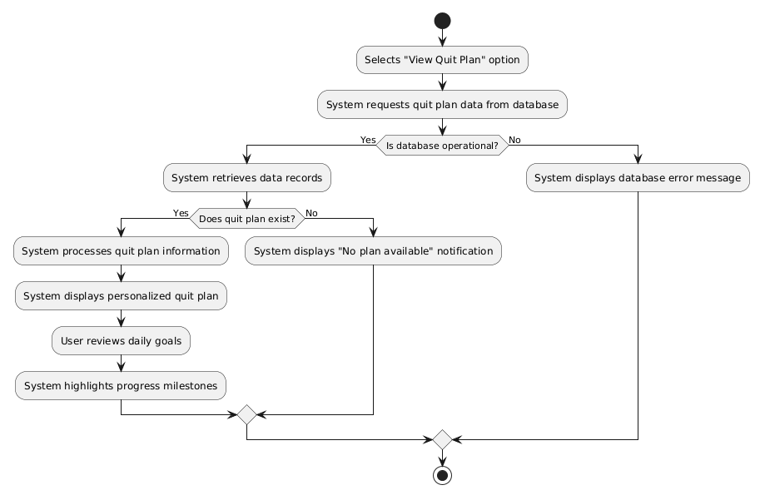
Activity Diagram for View Quit Plan

Slide 12
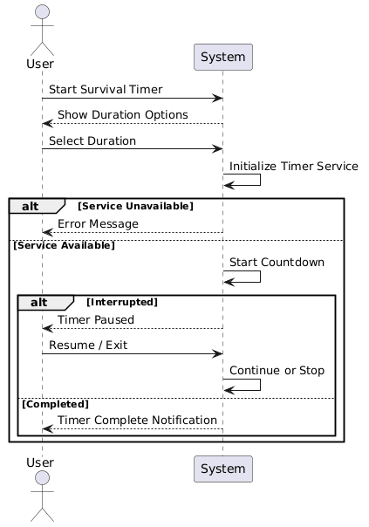
Sequence Diagram for Start Survival Timer

Slide 13
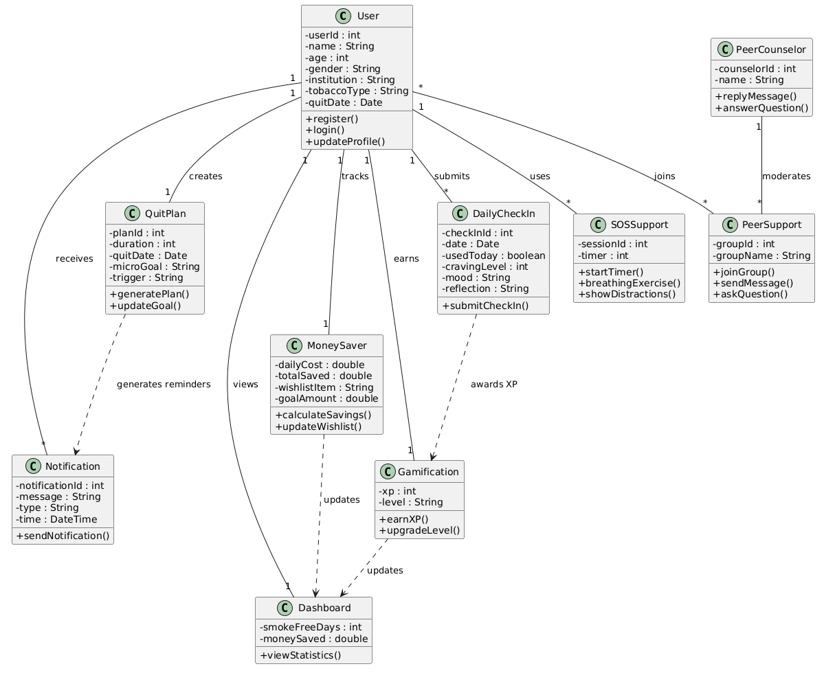
Class Diagram

Slide 14


Conclusion
Tobacco addiction is a serious health problem, and quitting is often difficult without proper support. Our Tobacco Quit Support app is designed to guide and motivate users throughout their quitting journey. By providing personalized plans, daily motivation, and community support, the app helps users build healthier habits and stay tobacco-free. We hope this solution will make quitting easier and contribute to a healthier society.

Slide 15
THANK YOU

